Slide 1


FAIR Data @ European Spallation Source
Jonathan Taylor & Tobias Richter
European Spallation Source, Data Management and Software Centre
PaNOSC General Assembly, November 2019 Trieste, Italy
This project has received funding from the European Union’s Horizon 2020 research and innovation programme under grant agreement No. 823852

Slide 2

ESS Status Construction project – first science in 2023
Partner | ESS
Catalogue | SciCat
URL | https://scicat.esss.se
Login required | Yes
File formats | NeXus
Database | MongoDB
Language | Javascript
Main technologies | Angular
Number of public datasets/files | 181/250,000
Using OAI-PMH | Almost
Minting DOIs | Yes
Data/embargo policy | Embargoed for 3 years
Number of instruments connected to data catalogue | 1
Yet, we already have:
Data Policy
Data Catalogue
Open (FAIR?) Datasets

Slide 3
ESS Policy for Scientific Data
Applies to non propriety use beam time only
Existence of a curated data policy helps users submit papers
Acceptance of policy is a condition of facility access
ESS will store all raw and meta data for a minimum of 10 years after the restricted access period ends
Metadata will be catalogued with reference to raw data
All raw data will be given a citable DOI
ESS (DMSC) will act as custodian
Access to raw & metadata is restricted for 3 years
Post embargo access to catalogue and data will be open inline with ERIC statutes

Slide 4
ESS Data Policy for Scientific Results
Data volumes will necessitate storage of results (=derived & analysed) datasets on ESS systems
ESS/DMSC will curate results on a best effort basis
Access to results remains restricted
Ownership and IP is determined by the specific user agreement subject to the ESS IP & inventions policy

Slide 5


SciCat
Data Catalogue with automatic metadata capture/ingestion pipeline and handling of processing workflows
Document store lends itself to flexible handling of domain specific metadata
https://scicat.esss.se
https://github.com/scicatproject
Deployed at ESS, MAX IV & PSI (+BAM)

Slide 6
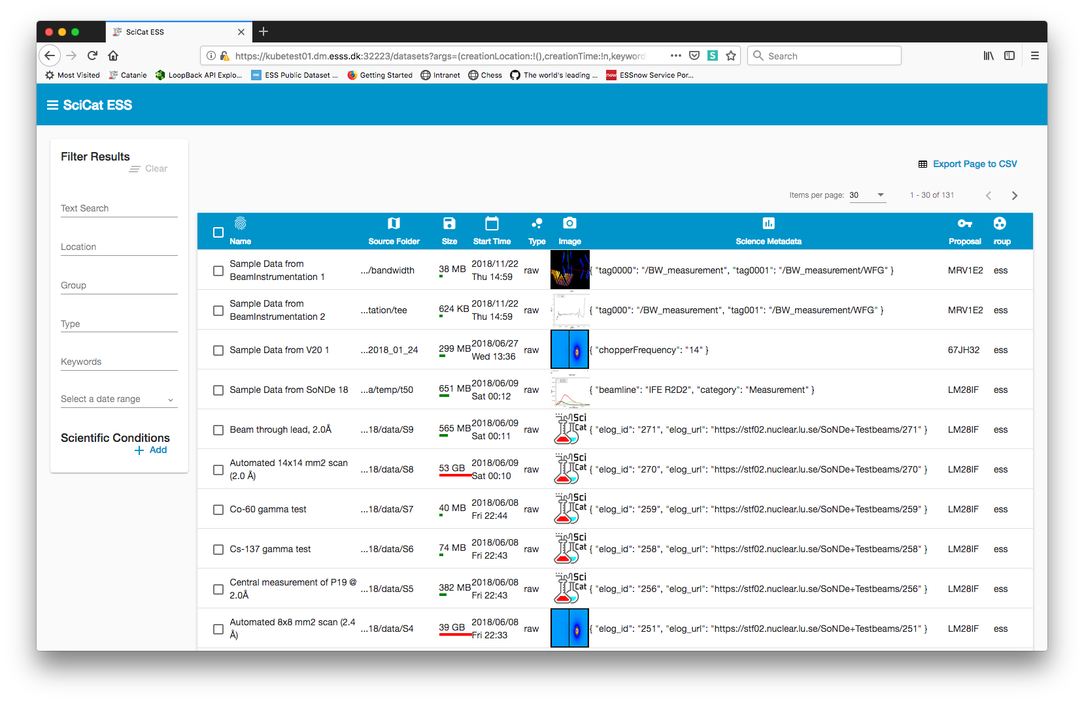
Data Catalogue - SciCat
Search and filter
Previews of data
CSV export
Sortable , filterable table
Notes:
We have a searchable table in the catalogue
Users can add preview of their data
CSV export so they can work with Excel if they want

Slide 7
How do we ensure data is FAIR and not just open?

Slide 8
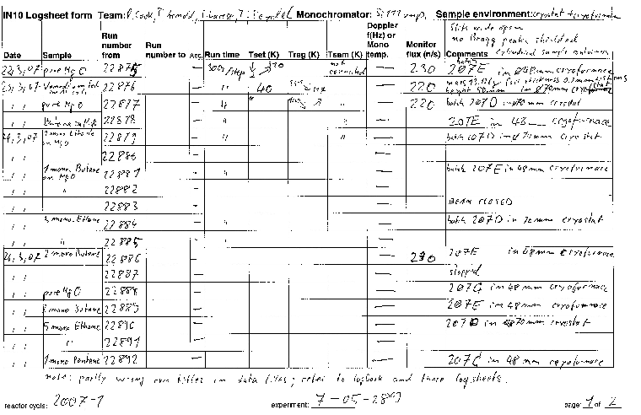
A written "logbook" from IN10 (when it was still running)

Slide 9

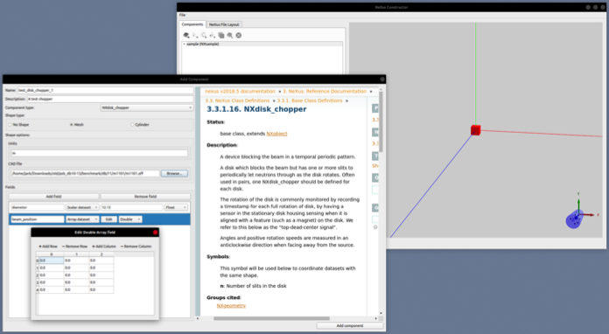
NeXus Geometry Constructor
ESS File Writer writes standard NeXus files with all metadata and geometry information embedded.
JSON configuration for the file writer can be constructed, modified, visualised and updated using this GUI tool that helps the user to make valid choices on selection of metadata.
We see live inspection of what goes into the file as a key aspect.
Work in Progress
https://github.com/ess-dmsc/nexus-constructor

Slide 10
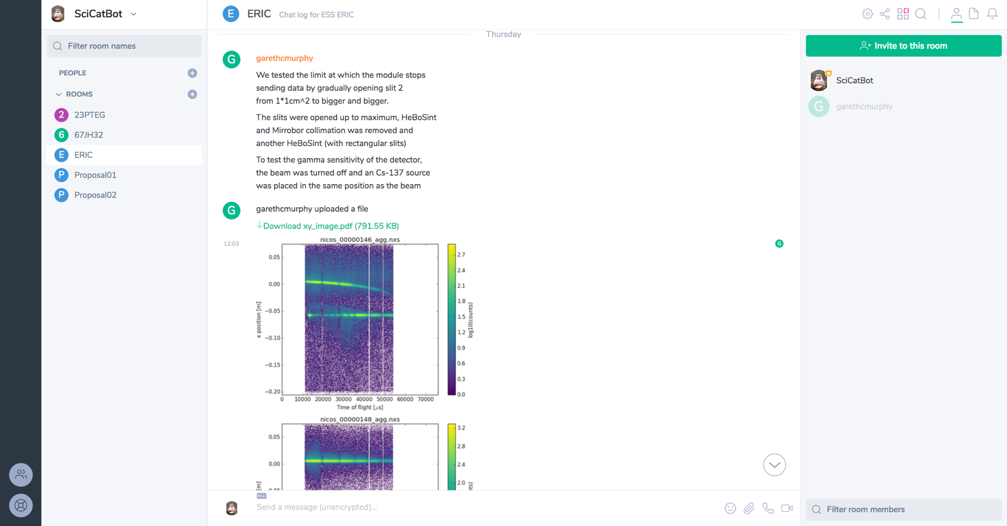
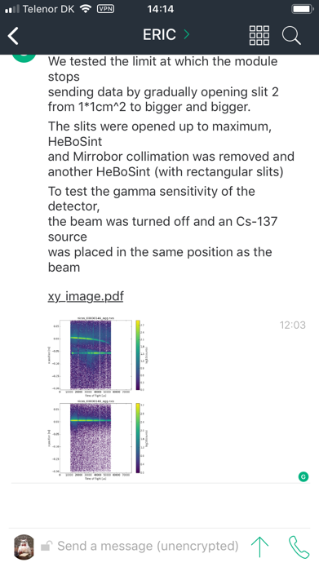
Matrix / Riot Chat Logbook – SciChat

Slide 11
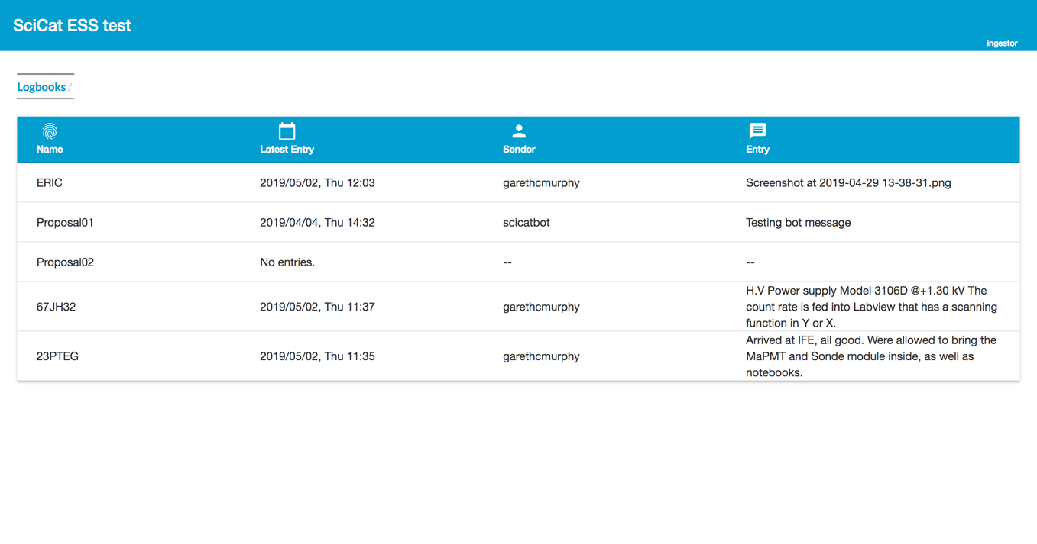
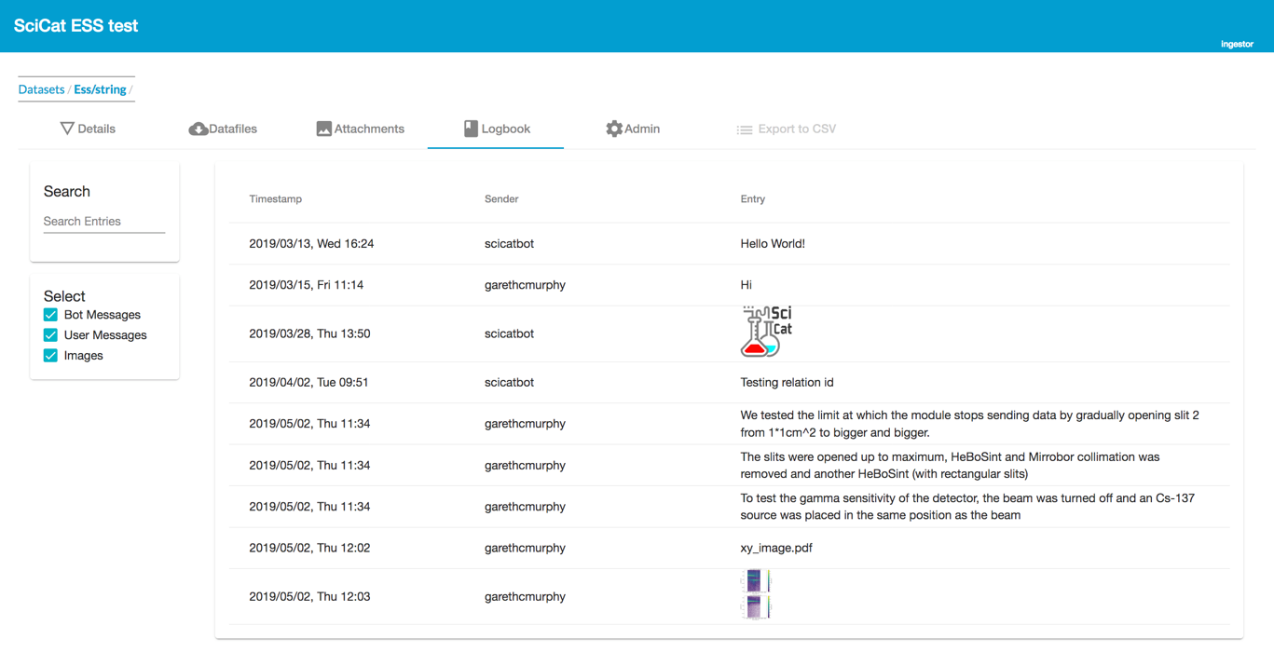
SciCat Logbooks View

Slide 12
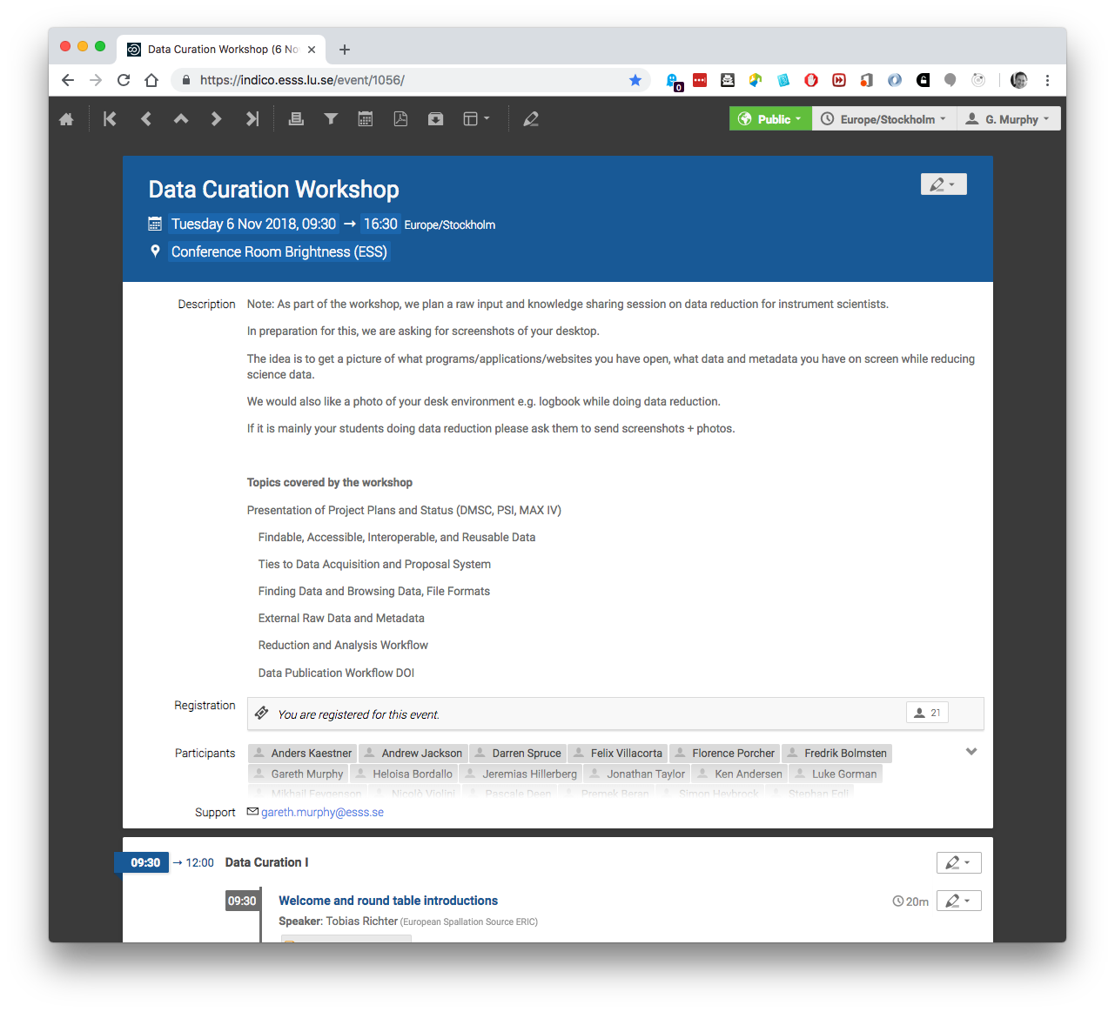
Data Curation Workshops
In a series of workshops we have gathered input from scientists on data curation topics.
It is an ongoing consultation process.

Slide 13
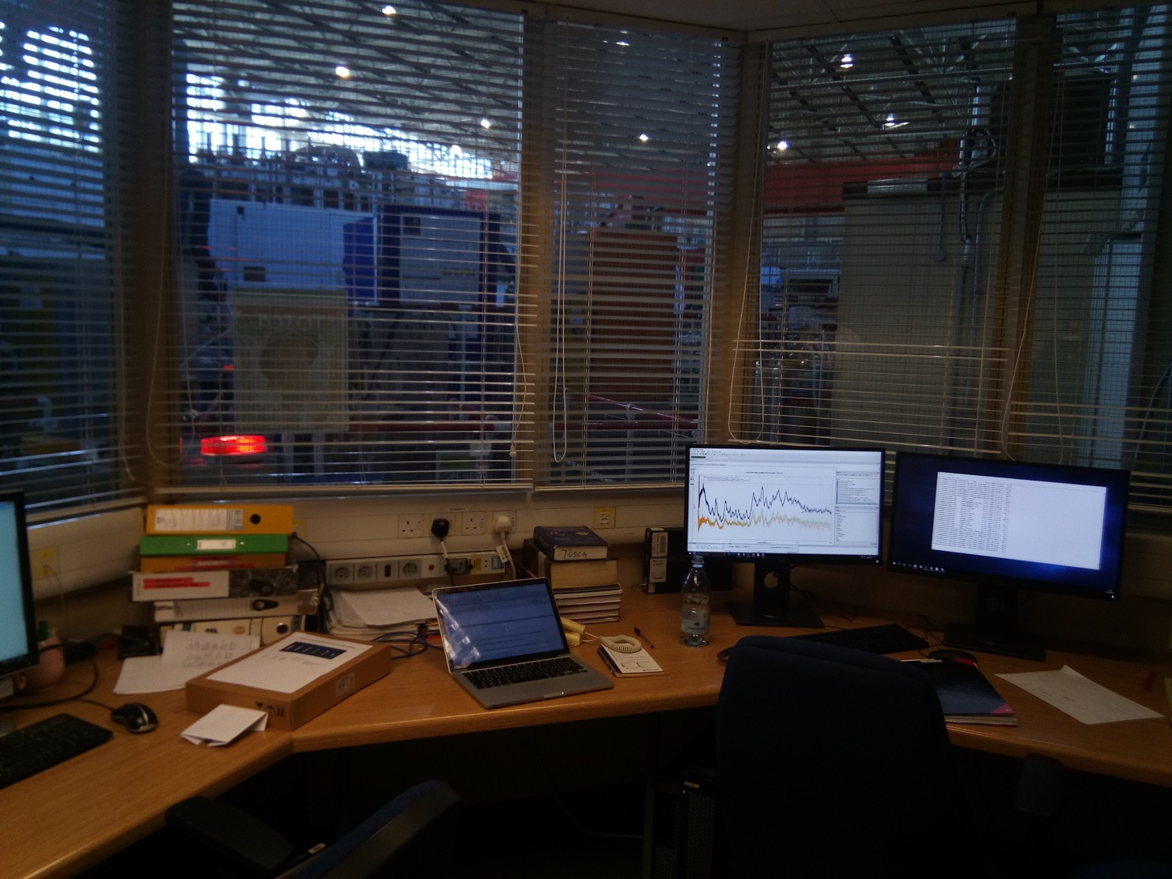
the TOSCA team (ISIS, RAL, UK) kindly provided me with a picture
taken in the their cabin: the PC screen shows the MANTID software which is
used for the data reduction from
time-of-flight raw histograms to energy transfer spectra.

Slide 14
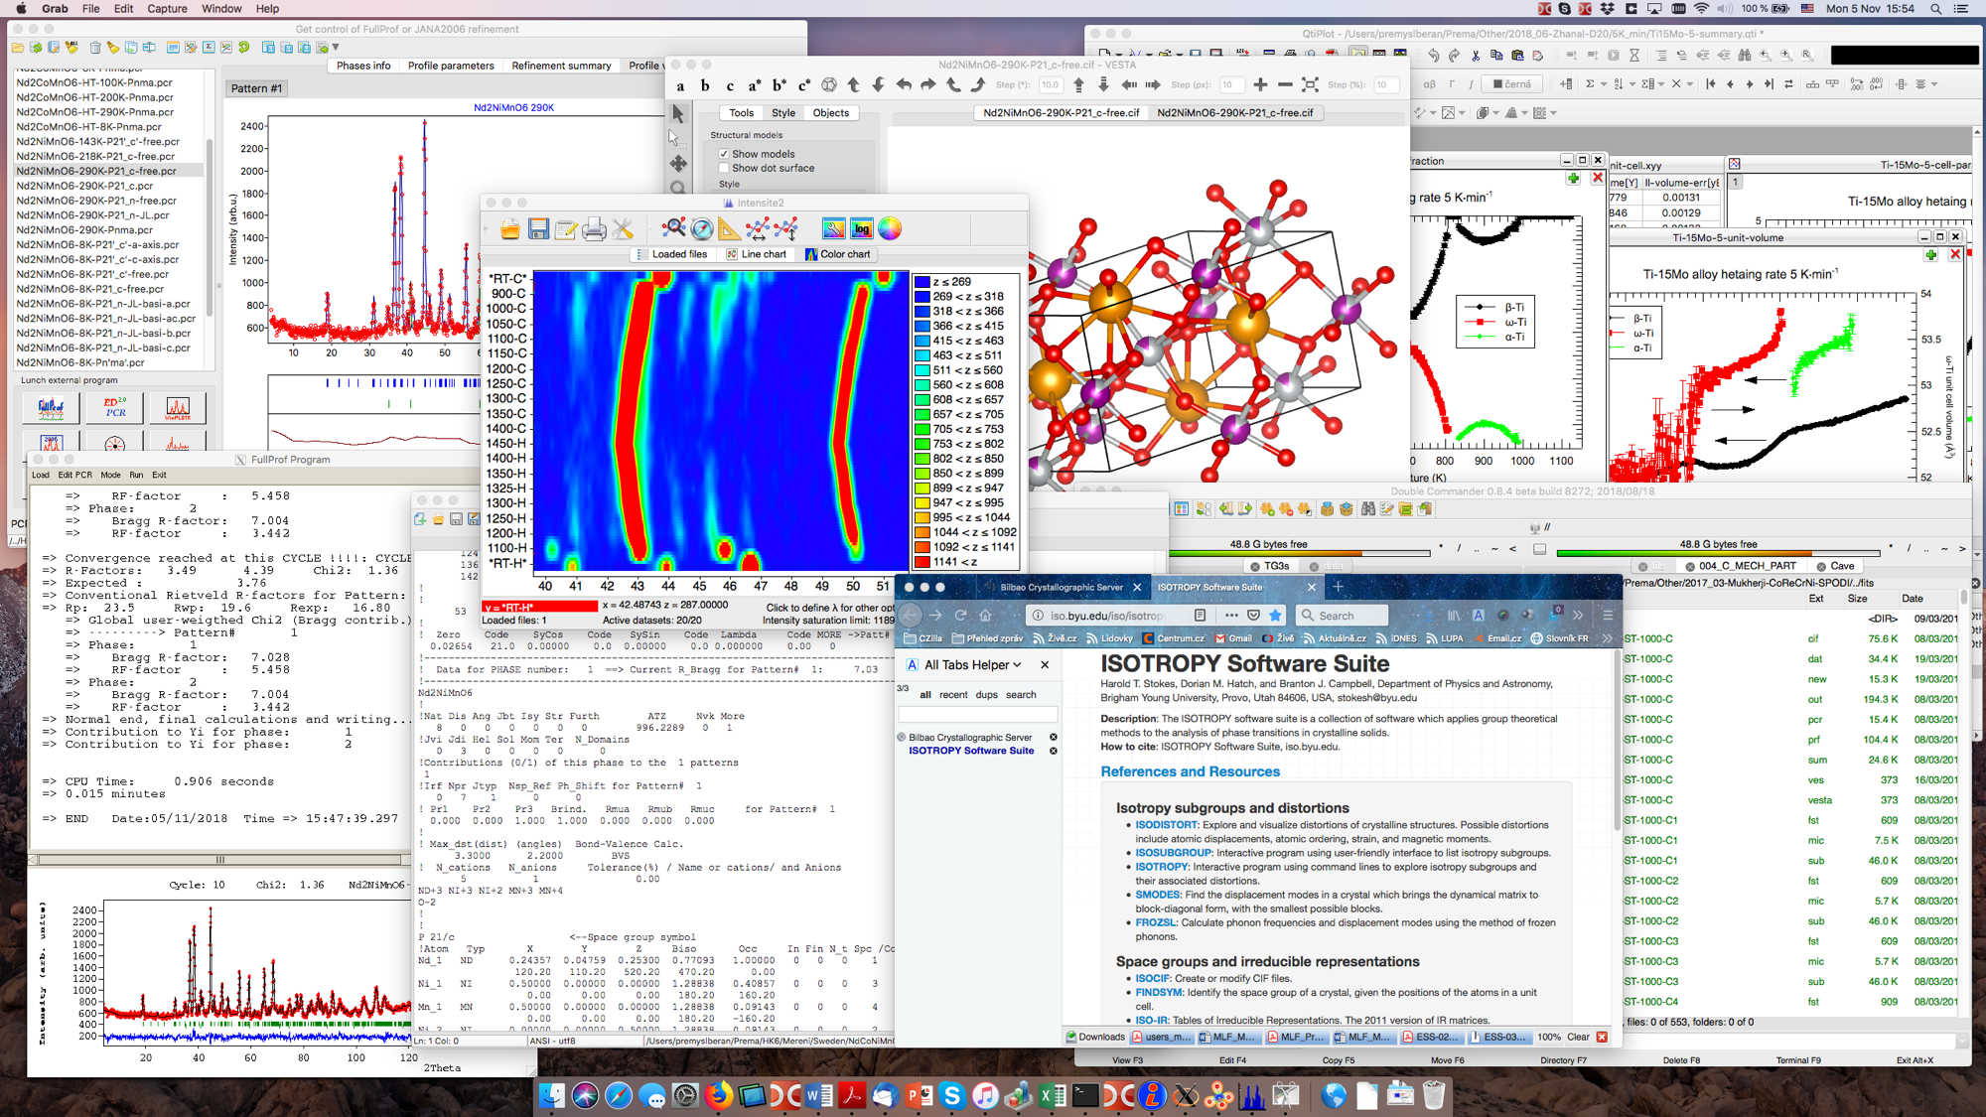
Premek Beran
Notes:
One user sent an example of the different software he uses, graphs he plots, manuals he reads
Complex data with different formats, many sources of metadata
We would like to simplify this progress for scientists

Slide 15
User feedback from workshop
It is difficult to replicate data reduction setup from user facility to home
Most scientists don’t use data catalogues to access data
Catalogue should help with analysis and reduction but not get in the way
Catalogue should be simple to use
Catalogue should be fast

Slide 16
Conclusion
Our Data Policy is approved.
Our Data Catalogue is fit for purpose.
We are working on making datasets “As FAIR As Reasonably Achievable” (AFARA).
We had an early start.
That means the pressure is on when we go live.
😎
😱

